Slide 1
Attendance with face recognition
Submitted by:- Guided By:-
Anmolpreet Singh Dr. Vinay Chopra
Devesh
Laksh Chanan
Radhika Sharma

Slide 2
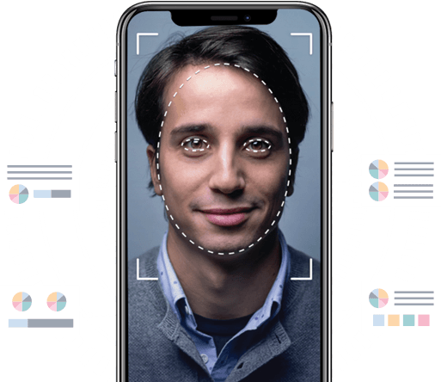
Introduction
Attendance is an important part of daily classroom evaluation. At the beginning of class, it is usually checked by the teacher.
But it may appear that a teacher may miss someone’s attendance.
To tackle this problem, we built a system for taking attendance by using face recognition technology.

Slide 3
Objective
To develop a portable Smart Attendance System which is handy and self-powered.
To ensure the speed of the attendance recording process is faster than the previous system which can go as fast as approximately 3 second for each student.
Have enough memory space to store the attendance.
Allow students to store their faces by using a GUI.
Able to show an indication to the user whether the face- recognition process is successful or not.

Slide 4
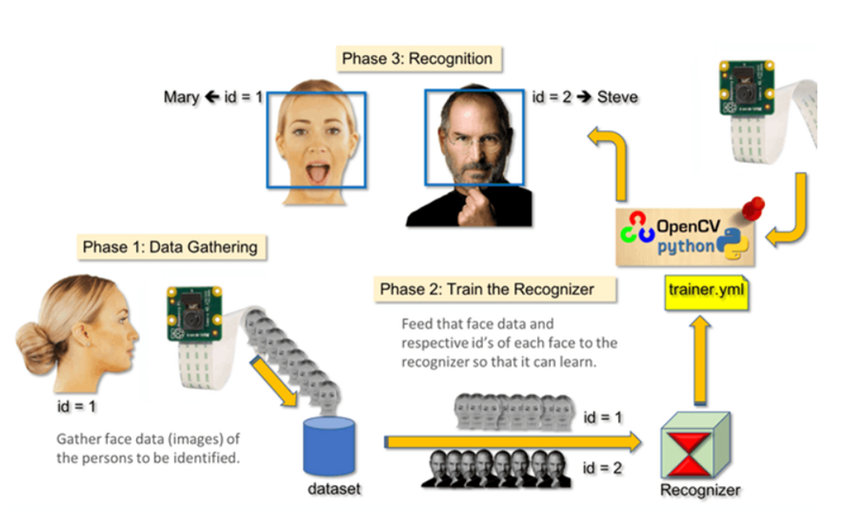
Phases of Project

Slide 5
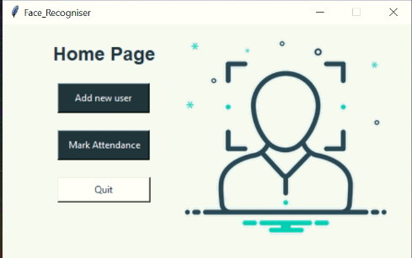
Home Page
This is the home page of our project.
Here we can add user’s face or mark attendance of existing user.

Slide 6
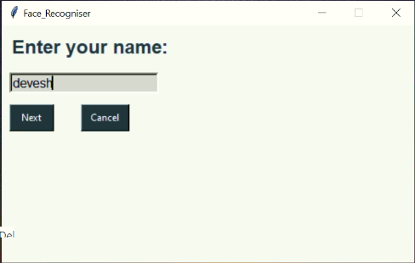
New User Page
After clicking “Add new user” we will be redirected to this page.
This page asks the user to enter their name.

Slide 7
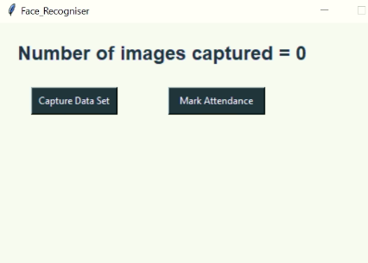
Add Data Set
On adding user’s name, we will be redirected to this page.
This page will start capturing the data set once the user clicks “Capture Data Set”.
This page also provides option to mark attendance once the dataset have been captured.

Slide 8
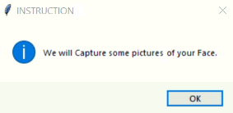
Instruction page
After clicking “Capture Data Set” on the previous page we will get this message box.

Slide 9
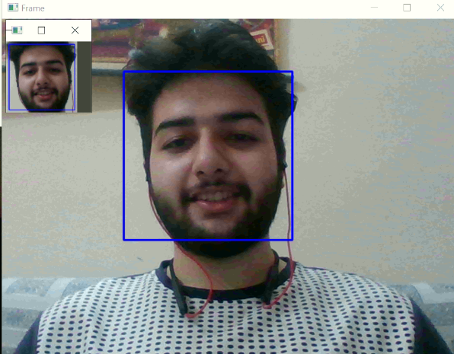
Camera Frame
This will capture the several images of user’s face.
The images which are captured will be stored in the form of “.npy ” file.
This file is stored in directory named “data”.

Slide 10
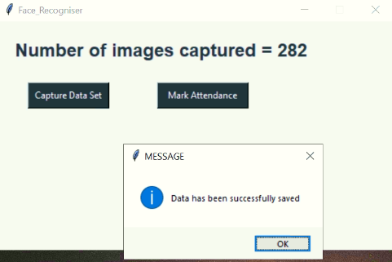
Add Data Set after capturing face
Once the data set has been captured and stored in the “data” directory popup message appears “Data has been successfully saved”.
The “Add Data Set” page will display the total number of images captured.

Slide 11
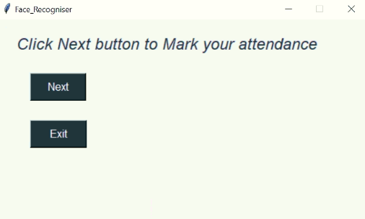
Attendance Page
This page will appear when we will click “Mark Attendance” on “Home Page” or “Add Data Set” Page.
On clicking next we will be redirected to the page where the app will open the camera for attendance.

Slide 12
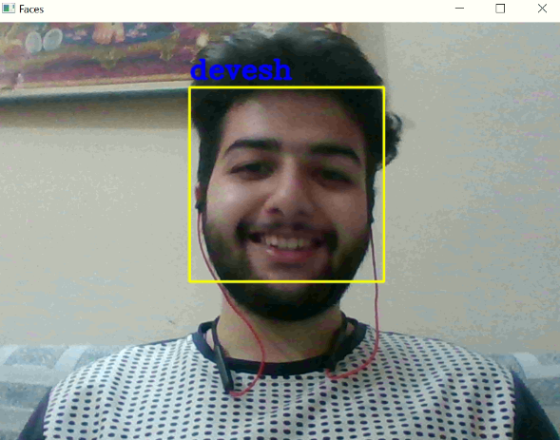
Mark attendance
After clicking “Next”, the software opens webcam to mark attendance.
The software recognizes the person using the KNN algorithm.
The name of the person is displayed on the leftmost corner of the box.
Attendance is marked in a “csv” file in the format name , date and time of arrival.

Slide 13
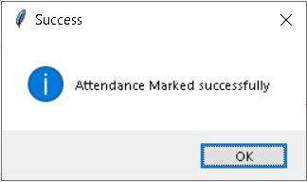
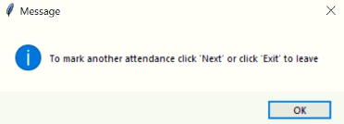
Another Attendance
Once the attendance is marked, success message will be displayed on the screen.
After the success message app prompts the user to exit or mark another attendance.

Slide 14
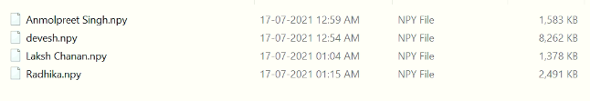
NumPy array files
These are the files containing images captured of various users so that the software can recognize their facial features.

Slide 15
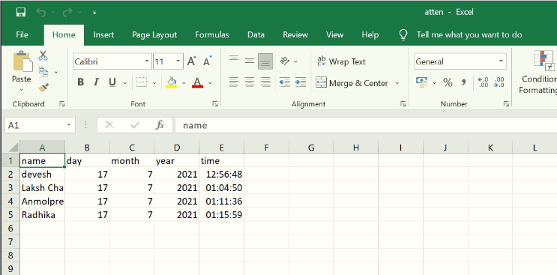
Excel file
This excel file contains the attendance of the users.
Data contains the name of user and the date and time.

Slide 16
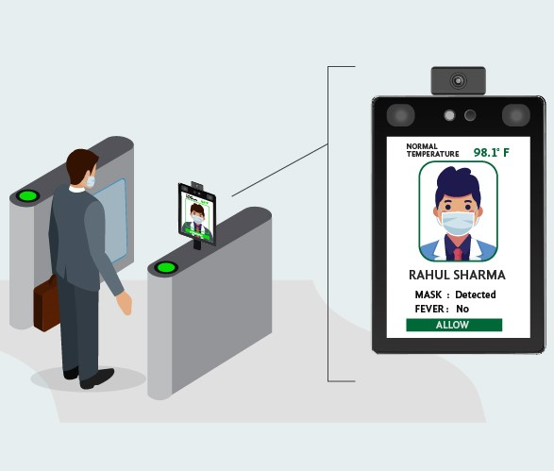
Scope
The targeted groups of the attendance monitoring system are the students of an educational institution.
Attendance can be recorded for 1 person at a time even if the software detects multiple faces.
An excel sheet is created which contains the user’s attendance.

Slide 17
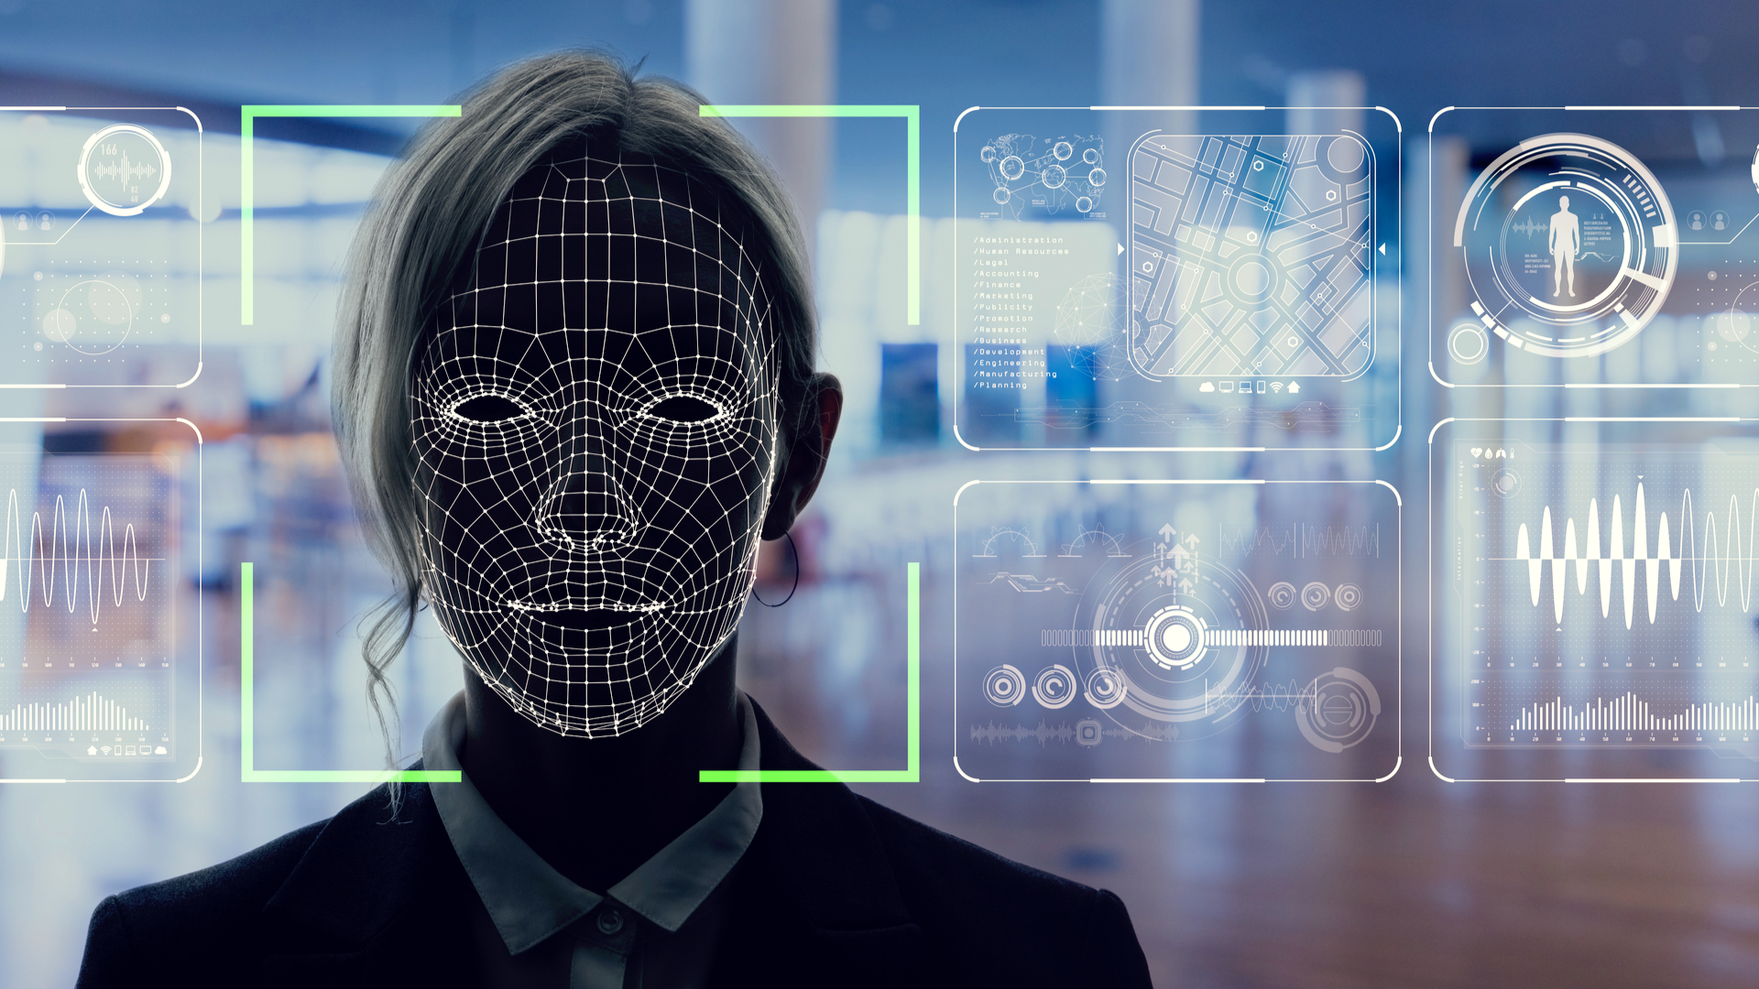
Drawbacks
Side face recognition
While capturing and recognizing face insured that there is proper lighting in room.
Attendance of identical twins may cause error.

Slide 18


